Slide 1
PROG8151 - User Interface Design Principles A3- Mobile Design
SBC MOBILE Banking APP
Team Members
1. Keron Ranchhodbhai Balar
2. Jaicy Thomas John
3. Vedang Tushar Bhagare
4. Yashkumar Manishbhai Patel
5. Prashantkumar Ghanshyambhai Patel

Slide 2
Description of application
A Mobile banking application.
Key functionalities: User sign-in, account dashboard, transaction lists, investment details, and money transfer

Slide 3
Tools Used
Adobe XD for prototyping and design.

Slide 4
DESIGN PROCESS
How We Developed the Solution:
User Research: Surveys and interviews to understand user needs
Problem Identification: Identified user pain points like complex navigation and lack of customization
Solution Ideation: Brainstormed features and UI elements to address user needs
Prototyping: Created wireframes and high-fidelity prototypes for user feedback

Slide 5
Design Process (Contd…)
Approach to Problem-Solving:
Intuitive Navigation: Simplified menu structure for easy access to features
Personalization: Added customizable dashboard options
Accessibility: Ensured the app is usable for all users, including those with disabilities (Voice)
Efficiency: Streamlined common tasks like transfers and bill payments

Slide 6
Team roles and contributions
Roles in the Team:
Keron Ranchhodbhai Balar: Visual design and prototyping
Jaicy Thomas John: Competitive analysis and design documentation
Vedang Tushar Bhagare: Interaction design and wireframing
Yashkumar Manishbhai Patel: User research and usability testing
Prashantkumar Ghanshyambhai Patel: Implementation and testing
Teamwork Contribution:
Collaboration: Regular meetings to share progress and feedback
Specialization: Leveraged individual strengths for specific tasks
Communication: Maintained open lines of communication for efficient workflow

Slide 7
UX Strategy
UX Objectives:
User-centric design
Accessibility
Efficiency
Consistency
Security
Visual Appeal
Feedback and Responsiveness
Error Prevention and Recovery

Slide 8
UX Approach
Steps Taken:
User research
Competitive analysis
Wireframing and prototyping
Usability testing
Interaction design
Visual design
Documentation

Slide 9
COMPETITIVE research
CIBC Banking App:
Strengths:
Easy navigation: the app has a user-friendly interface, allowing users to easily navigate between accounts, transfers, and bill payments.
Quick transfers: Interac e-transfers are fast and straightforward, enhancing user convenience.
Personalized insights: the app provides personalized spending insights and budget tracking to help users manage their finances effectively.
WEAKNESSES:
Limited customization: users have limited options to personalize their dashboard and app settings.
Occasional technical issues: some users have reported occasional glitches and slow load times during peak hours.

Slide 10
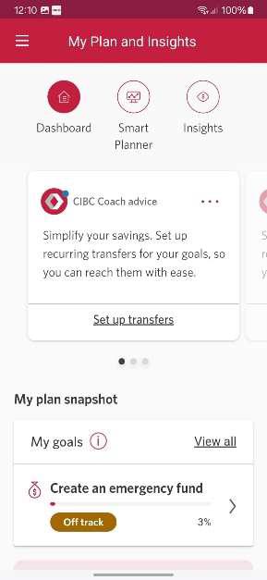
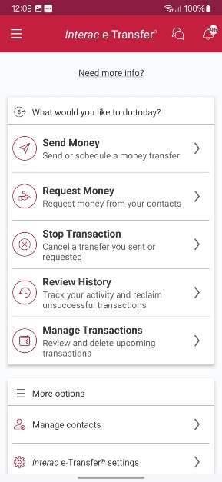
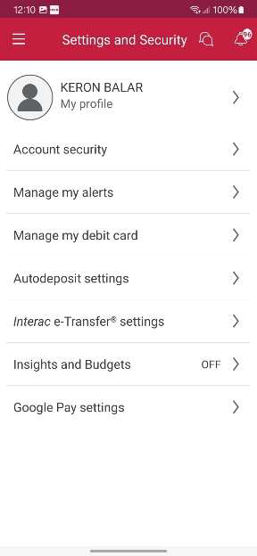
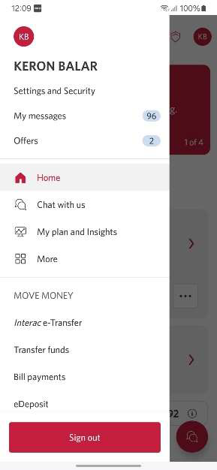

Slide 11
COMPETITIVE research (contd…)
Rbc Banking App:
Strengths:
Advanced security: the app features biometric login options, including fingerprint and facial recognition, along with robust encryption for transactions.
Customization: the app provides users with the ability to customize the dashboard and accounts.
Personalized insights: the app provides personalized spending insights and budget tracking to help users manage their finances effectively.
WEAKNESSES:
Complex interface for new users: new users may find the app’s interface complex due to the extensive features available.
Battery consumption: the app is known to consume more battery compared to other banking apps, which can be inconvenient for users on the go.

Slide 12
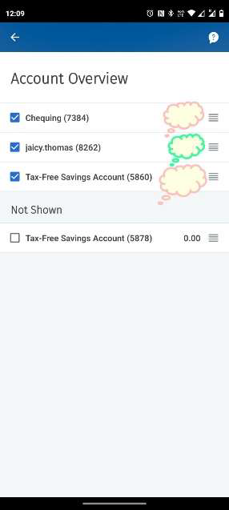
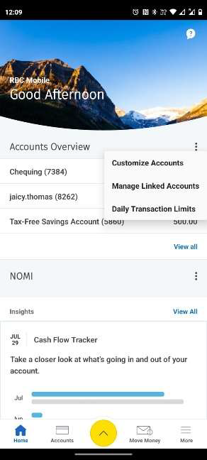
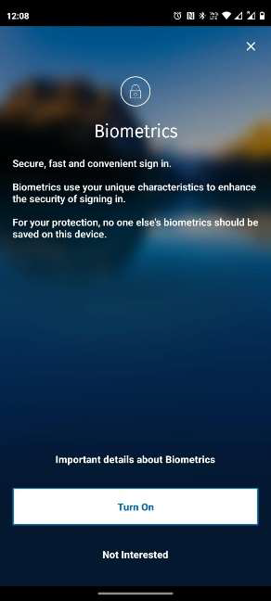
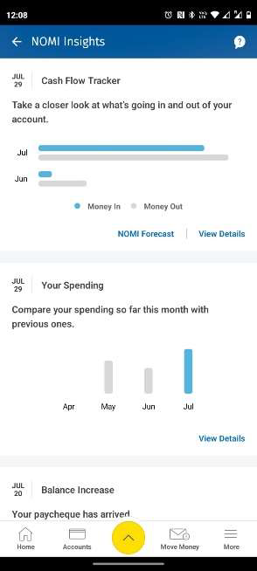

Slide 13
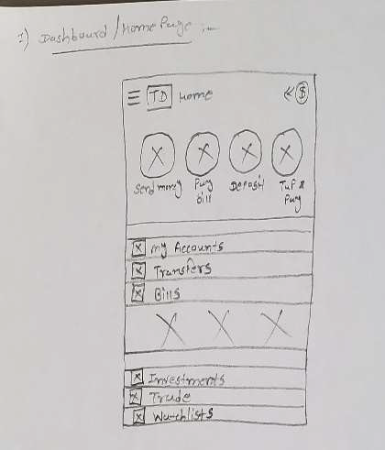
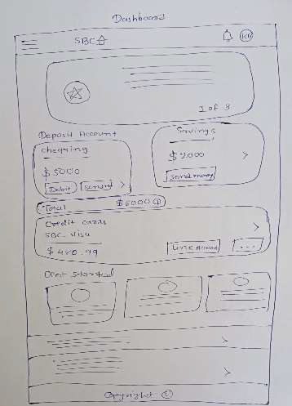
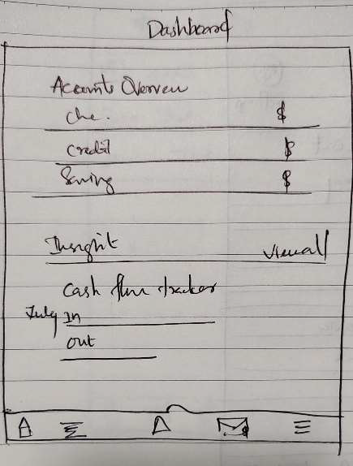
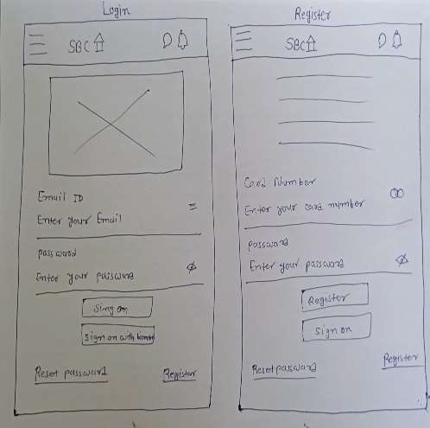
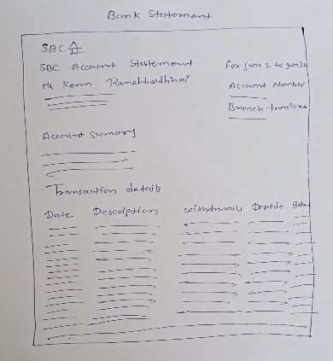
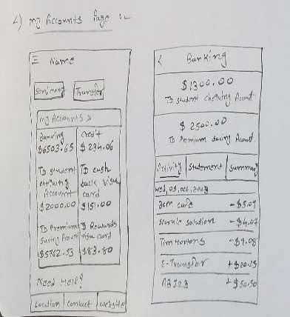
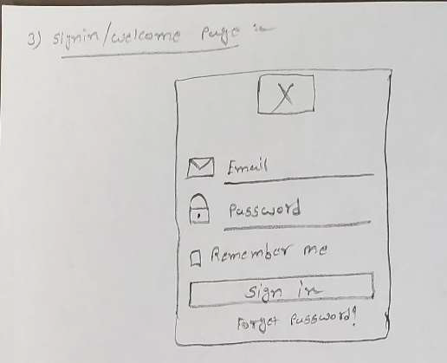
PROTOTYPES
SKETCHES

Slide 14
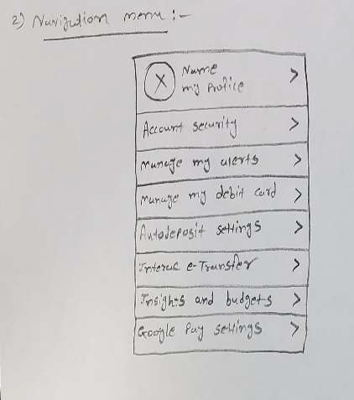
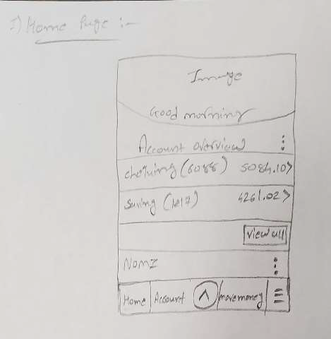
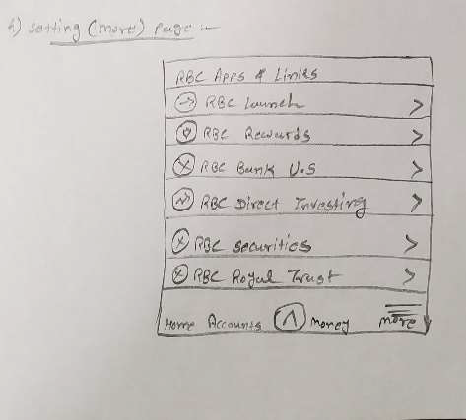
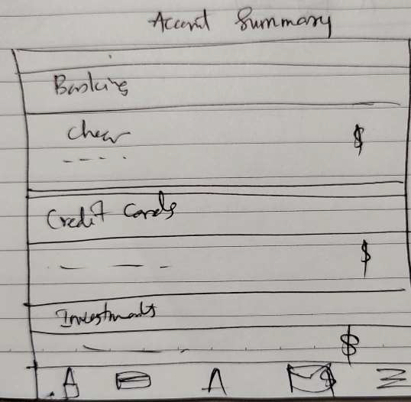
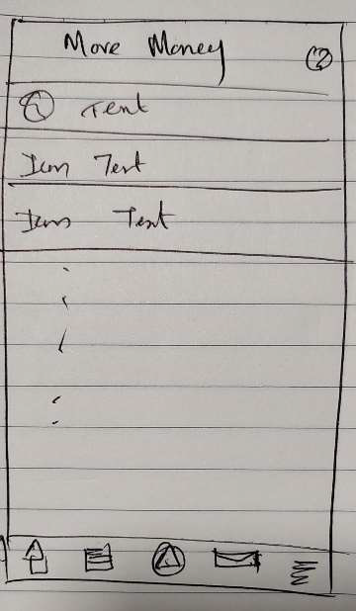
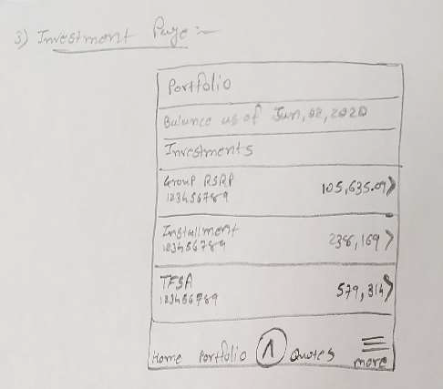
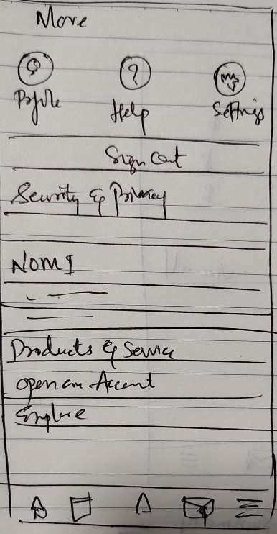
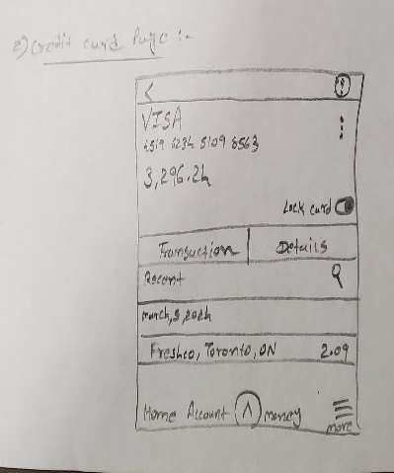

Slide 15
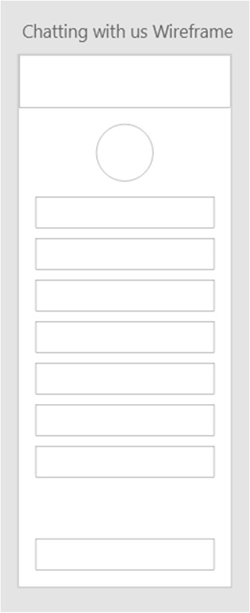
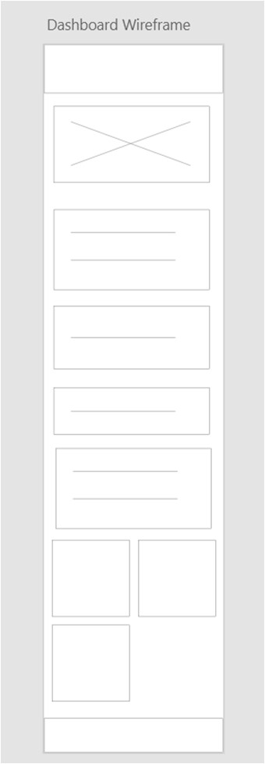
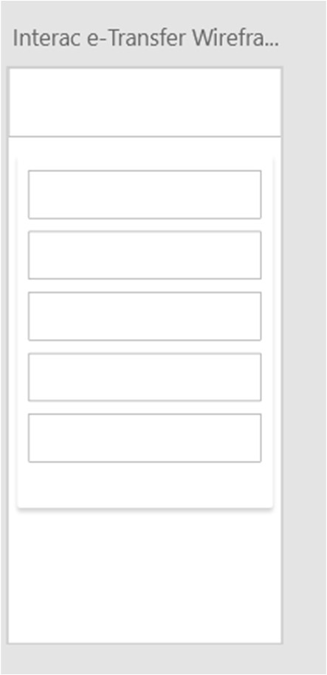
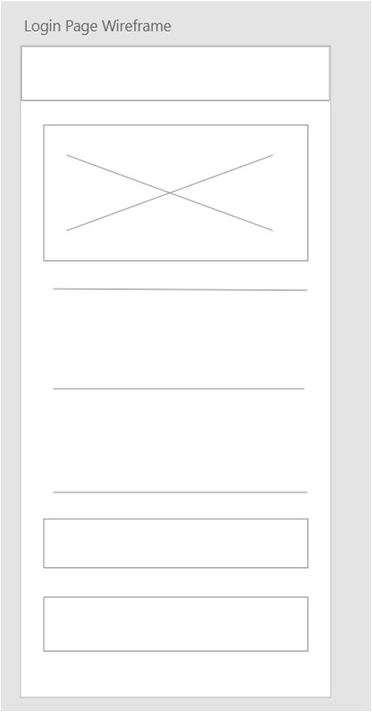
pROTOTYPES (Contd…)
wIREFRAMES

Slide 16
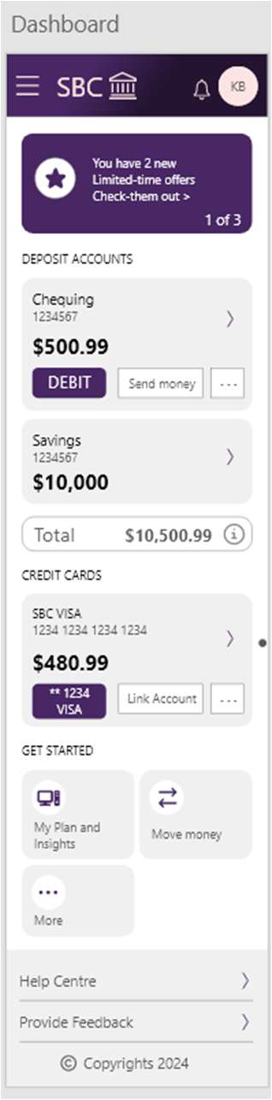
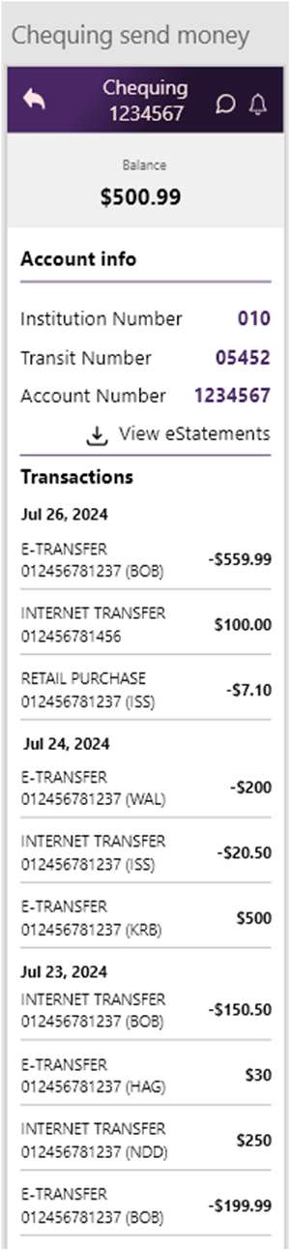
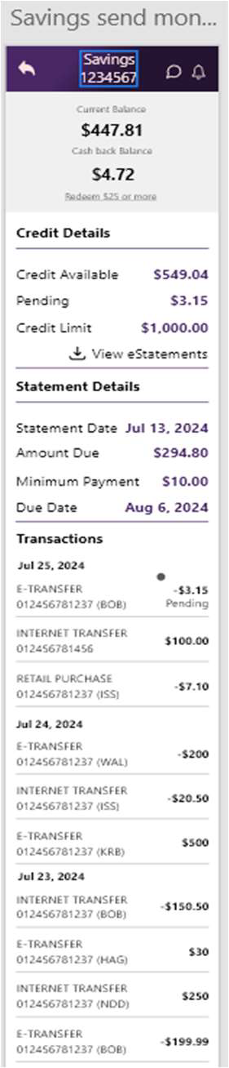
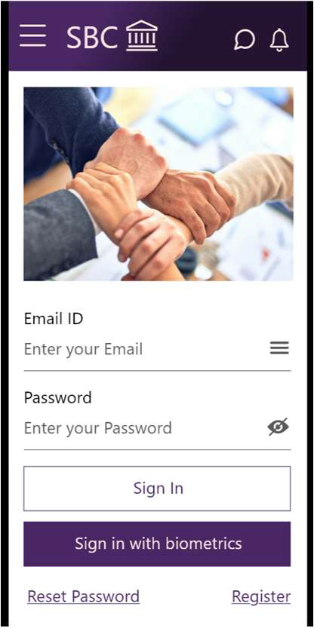
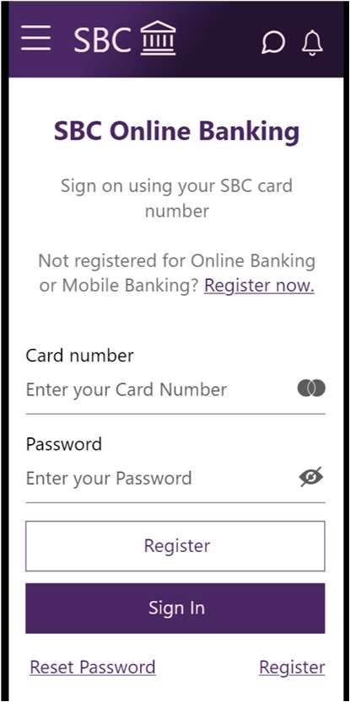
Prototypes(Contd…)
High-Fidelity prototypes

Slide 17
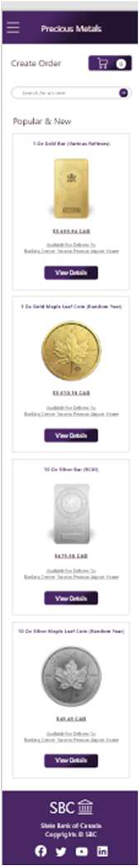
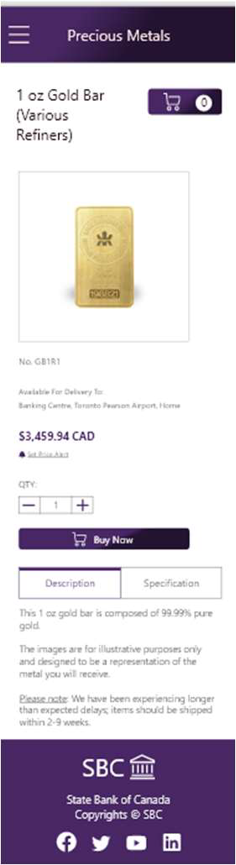
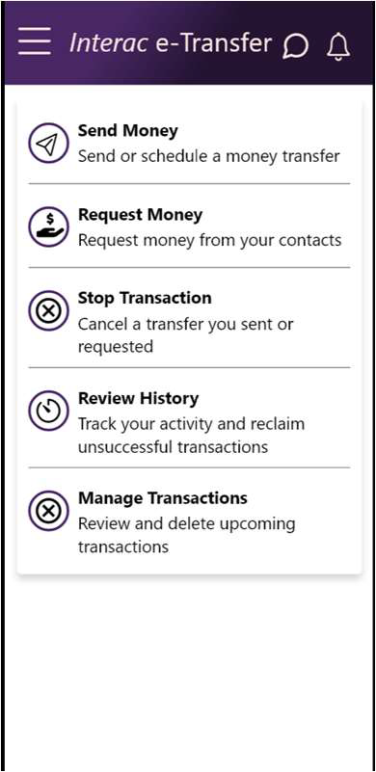
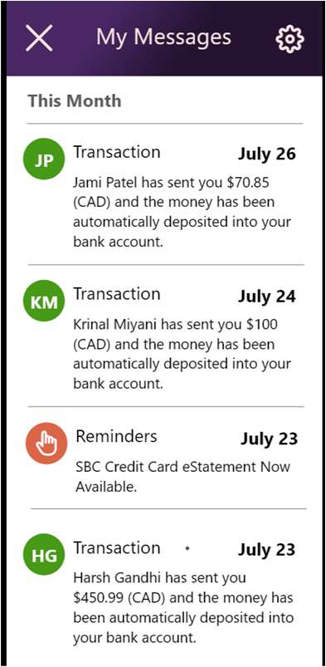
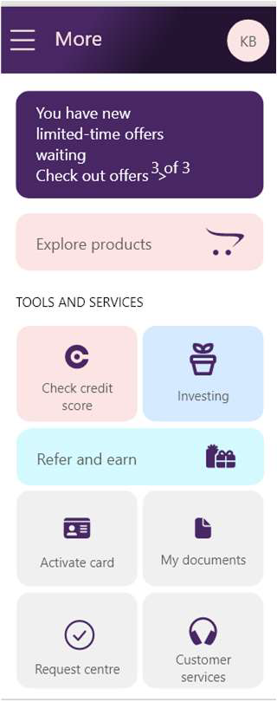

Slide 18
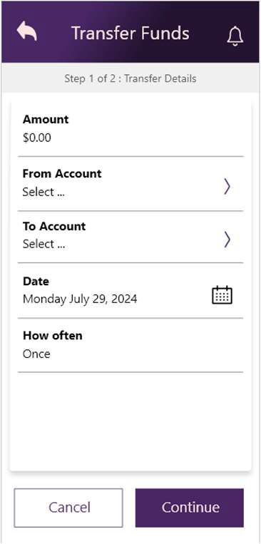
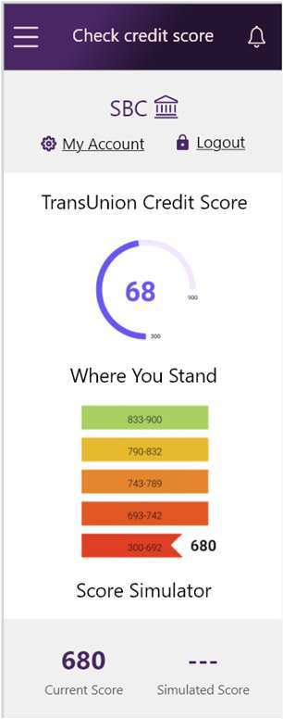
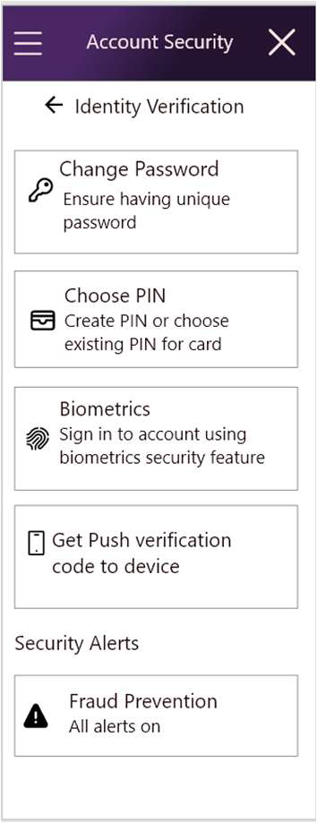
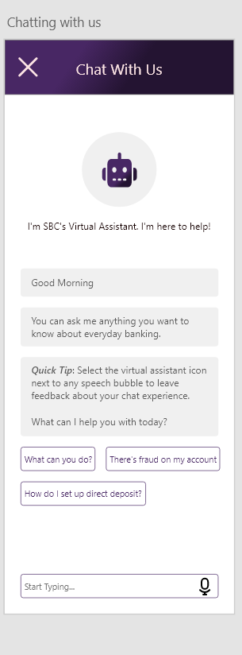
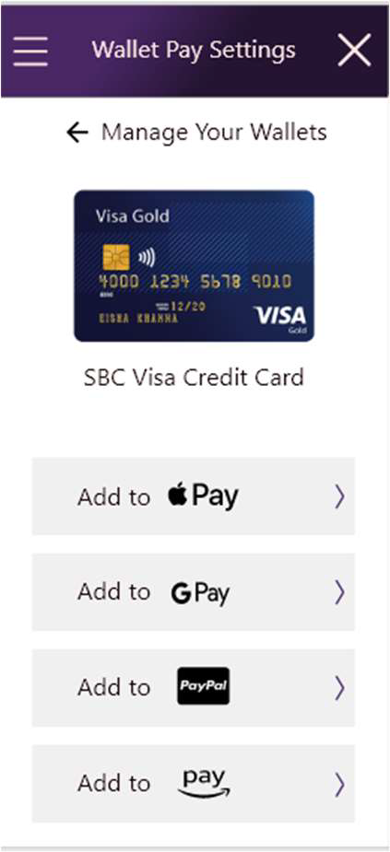
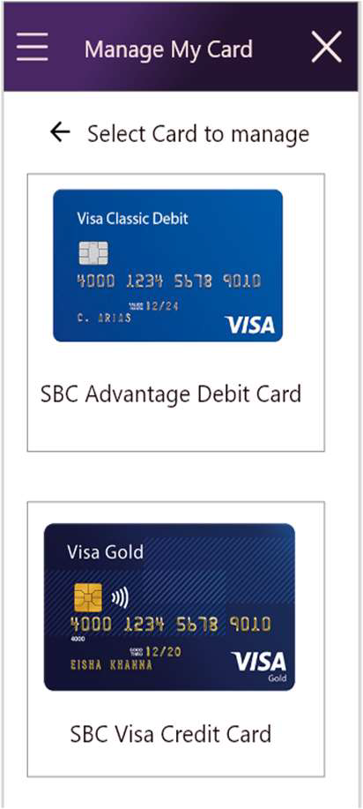
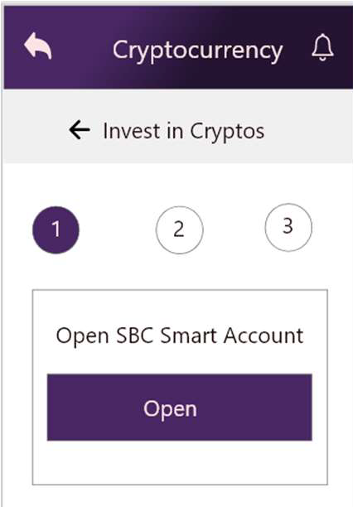

Slide 19
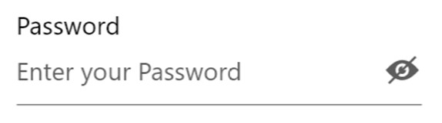

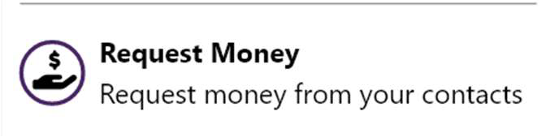
Design implementation
METAPHORS
Visibility Control Eye Icon: This metaphor helps users easily understand that they can check their password input for accuracy or conceal it for privacy.
Notification Bell Icon: This metaphor helps users intuitively understand that clicking the bell icon will provide them with notifications, similar to how a bell ringing in the real world signals an alert.
Request Money Icon: This metaphor helps users intuitively understand that clicking this icon will allow them to request money from others, making the process of asking for payments or reimbursements straightforward and recognizable.

Slide 20
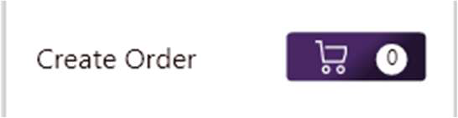

Shopping Cart Icon: This metaphor helps users intuitively understand that clicking this icon will allow them to add items to their order, review selected items, and proceed to checkout when ready. It simplifies the process of online shopping by mimicking a familiar real-world activity.
Speech Bubble Icon: This metaphor helps users understand that they can access their messages or start a new conversation by clicking this icon.

Slide 21
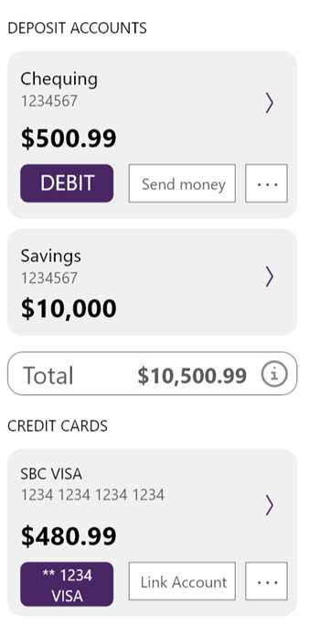
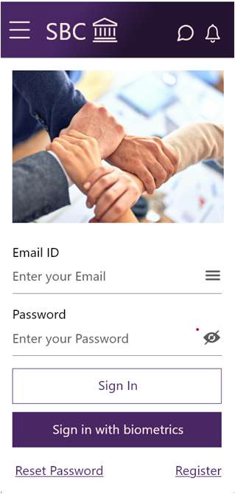
DESIGN IMPLEMENTATION (Contd…)
DESIGN PATTERNS
Card layout: Each account (chequing, savings, and credit cards) is displayed within its own card.
Form field design: This pattern helps guide users through the login process, providing a clear and direct method for inputting information, which is essential for usability and accessibility.

Slide 22
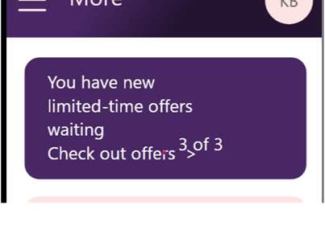


Notification banner: Informs users about new limited-time offers.
Grid layout: The tools and services are displayed in a grid layout, each represented by an icon and label. It organizes multiple options in a compact and visually appealing manner, making it easy for users to scan and select the desired service.
CALL TO ACTION BUTTON: Each item has a "view details" button that encourages users to explore more information about the product.

Slide 23
USABILITY PRINCIPLES
CONSISTENCY: All buttons for primary actions, such as "sign in" and "submit," use the same color and style throughout the app. This ensures users know what to expect when they see these buttons, making the app easier to navigate.
FEEDBACK: When a user submits a form to transfer money, an immediate confirmation message appears, indicating that the transfer was successful.
AFFORDANCE: Interactive elements like buttons and links are designed with shadows and highlights, making them appear clickable. For instance, the "send money" button looks raised, indicating it can be pressed.
SIMPLICITY: The app uses simple language and clear icons, avoiding unnecessary complexity. The main dashboard displays only the most critical information, like account balances.

Slide 24
ACCESSIBILITY: The app supports screen readers and includes high-contrast modes for users with visual impairments. Buttons are large enough to be easily tapped.
ERROR PREVENTION: Before finalizing a money transfer, the app shows a summary of the transaction details, allowing the user to confirm the information and catch any mistakes before submission.
RECOVERY: If a transaction fails, the app provides a clear error message with options to retry or contact customer support.
VISIBILITY OF SYSTEM STATUS: When loading account information, a spinner or progress bar keeps users informed that their data is being retrieved. This helps manage user expectations and reduces uncertainty.

Slide 25
USER CONTROL: Users can easily navigate back to the previous screen using a visible back button. They can also cancel ongoing actions, such as a money transfer, by pressing a cancel button.
LEARNABILITY: The app uses familiar icons and terminology that align with standard banking practices. New users can quickly learn how to use the app because it builds on their existing knowledge of banking.

Slide 26




PROTOTYPE MATCHES THE WIREFRAMES

Slide 27





Slide 28



USABILITY TESTING
We conducted a usability test of our banking mobile app's login page and received the following feedback from our colleagues:

Slide 29

USABILITY TESTING

Slide 30
THANK YOU! LET’S SEE OUR DESIGN

